Slide 1
Airline Profit Optimization Using Data Analysis
Focus: Revenue Growth via Occupancy & Pricing
Tools: SQL, Python (Pandas), Data Visualization

Slide 2
Business Problem
Airline margins are shrinking due to:
Rising fuel costs
High taxes & regulations
Fixed operational costs
Key Issue: Flights are operating, but not generating maximum possible revenue

Slide 3
Objective
Identify underperforming aircraft
Improve seat occupancy
Analyze pricing vs volume trade-off
Quantify impact of operational improvements
Goal: Maximize revenue per flight, not just number of flights

Slide 4
Data Scope
Dataset: Airline booking & flight operations data
Key entities:
Flights
Tickets
Aircrafts
Time period: Mid 2017
Data Quality: Clean, no missing values

Slide 5
Key Metrics
Occupancy Rate → Capacity utilization
Revenue → Total earnings
Avg Ticket Price → Pricing strength
Revenue = Volume × Price

Slide 6
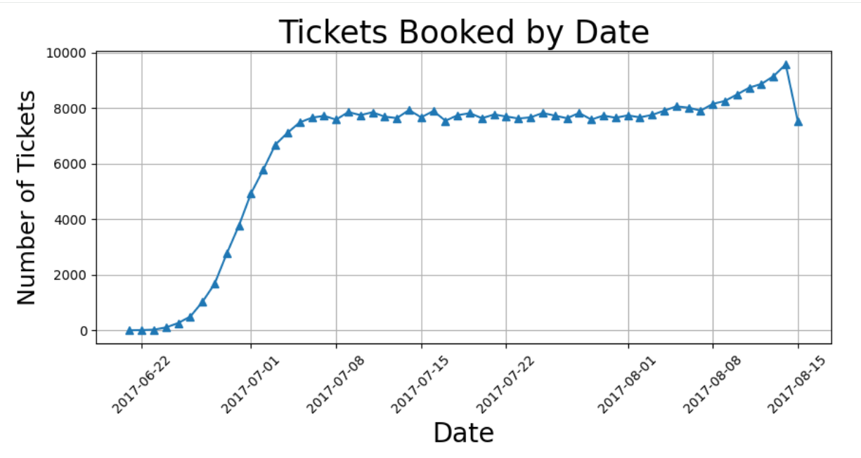
Demand Pattern Insight
Peak demand → Mid-July
Decline after August
Strong correlation:
More bookings = more revenue
Conclusion: Demand drives revenue more than pricing changes

Slide 7
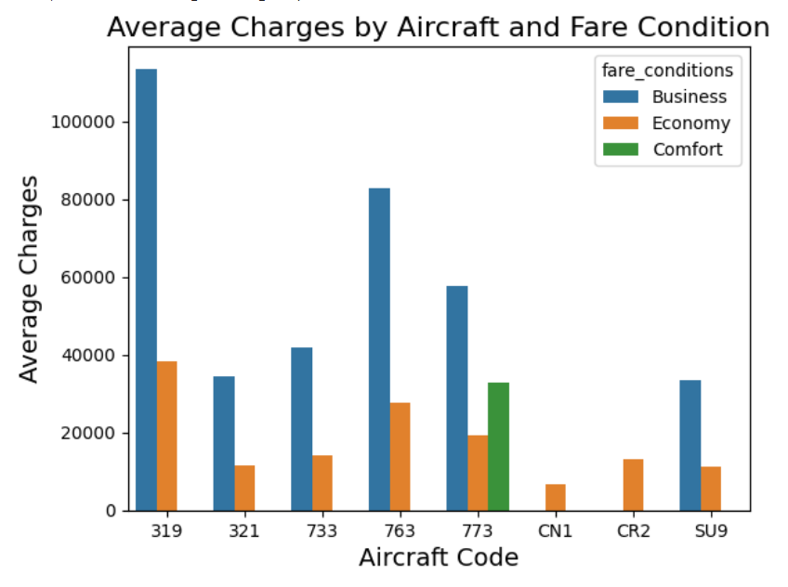
Pricing vs Volume Trade-off
Business Class → High revenue, low volume
Economy → High volume, low price
Key observations:
319 → premium pricing (high avg fare)
SU9 → mass volume, lower price
Insight: Different aircraft operate on different revenue models

Slide 8
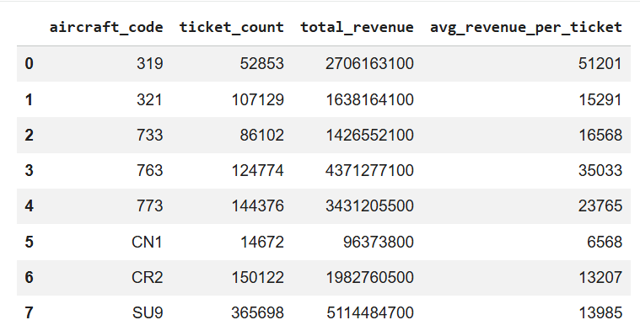
Individual Aircraft Performance
SU9 → highest revenue + highest ticket volume
319 → high value per ticket
CN1 → low revenue + weak pricing
Insight: Fleet is not optimized

Slide 9
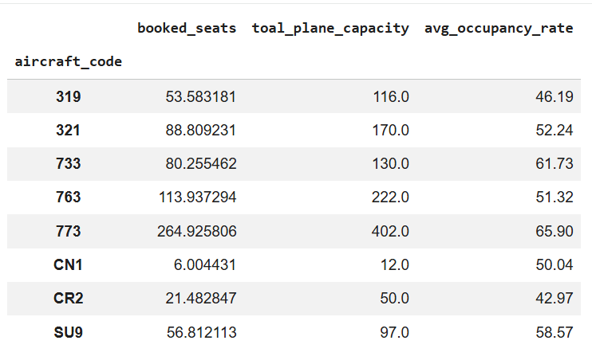
Occupancy Problem (Biggest Gap)
Most aircraft < 60% occupancy
Lowest performers:
CR2 (~43%)
319 (~46%)
Insight: Flights are flying half empty → direct revenue loss

Slide 10
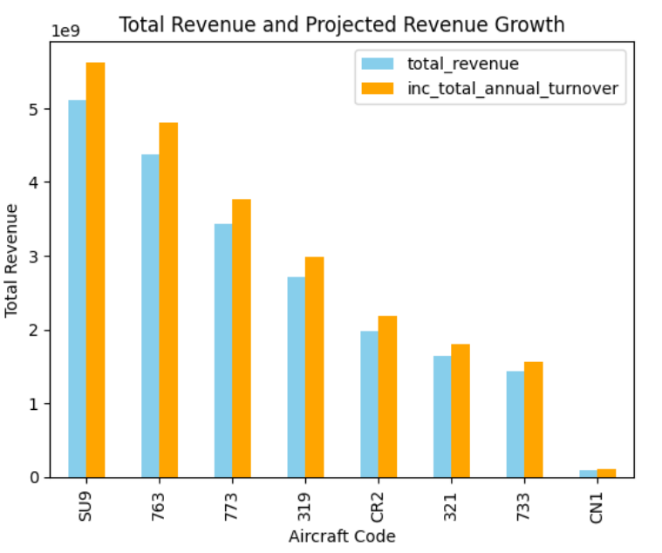
10% Occupancy Impact
SU9 → +511M revenue
763 → +436M
773 → +343M
Key Insight: Small efficiency gains → massive financial impact

Slide 11
Strategic Recommendations
1. Fix Occupancy First
Target low-load flights
Improve demand generation
2. Aircraft-Specific Strategy
SU9 → maximize volume
319 → maintain premium positioning
CN1 → redesign or reconsider usage
3. Demand-Based Pricing
Adjust fares based on seasonality
Avoid flat pricing strategy
4. Reduce Inefficiencies
Cut or optimize consistently low-occupancy routes

Slide 12
Final Takeaway
Main Insight: Profit growth is not about adding flights, It’s about maximizing each flight’s efficiency
“Better utilization beats expansion.”

Slide 13
END
Anis Ahmed : Data Analyst

